Slide 1
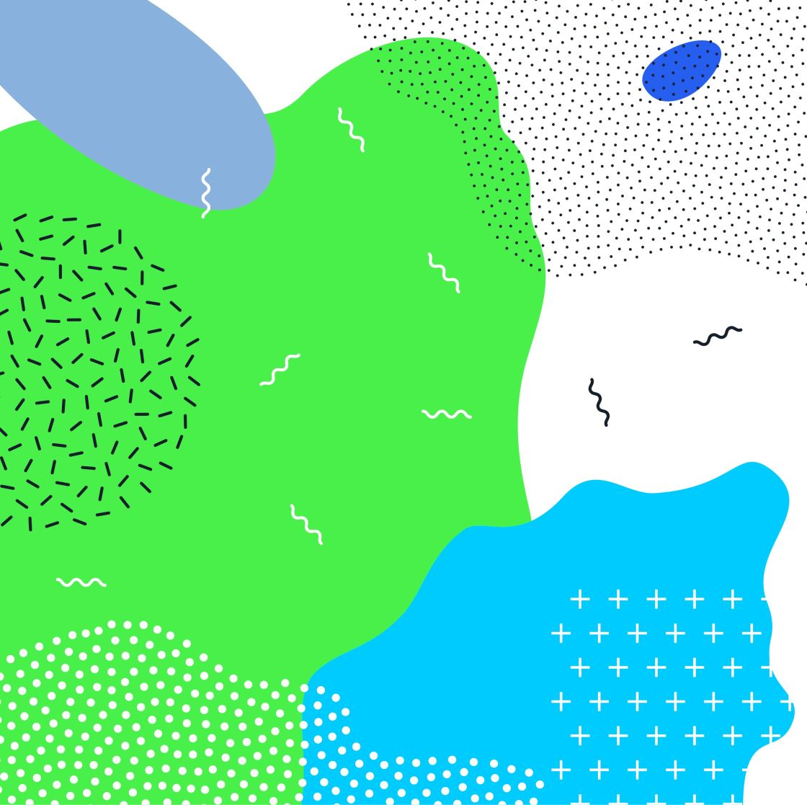
Science on saturday
Children from ks1 spent Saturday morning as scientists. We created our own volcanoes and then conducted a scientific investigation. The chemical reaction between vinegar and bicarbonate of soda allowed us to see a WOW moment as our volcanoes erupted on the school playground!

Slide 2
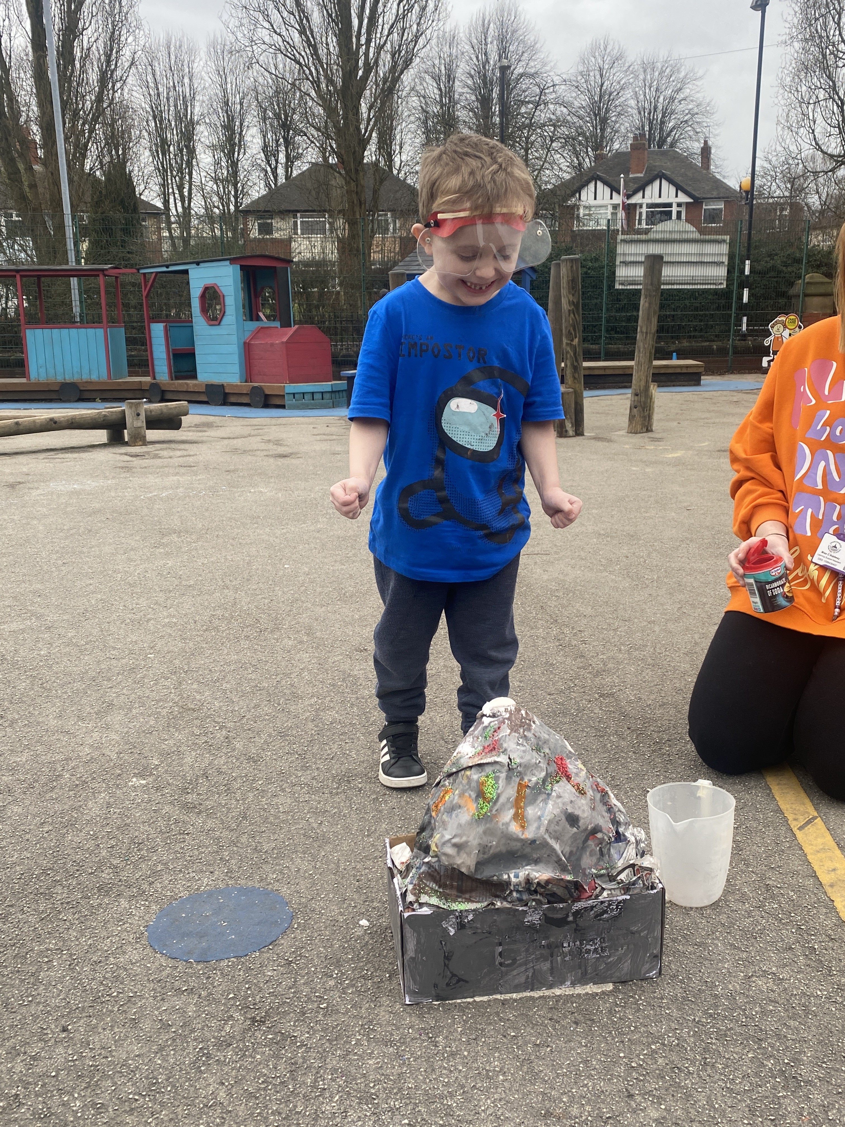
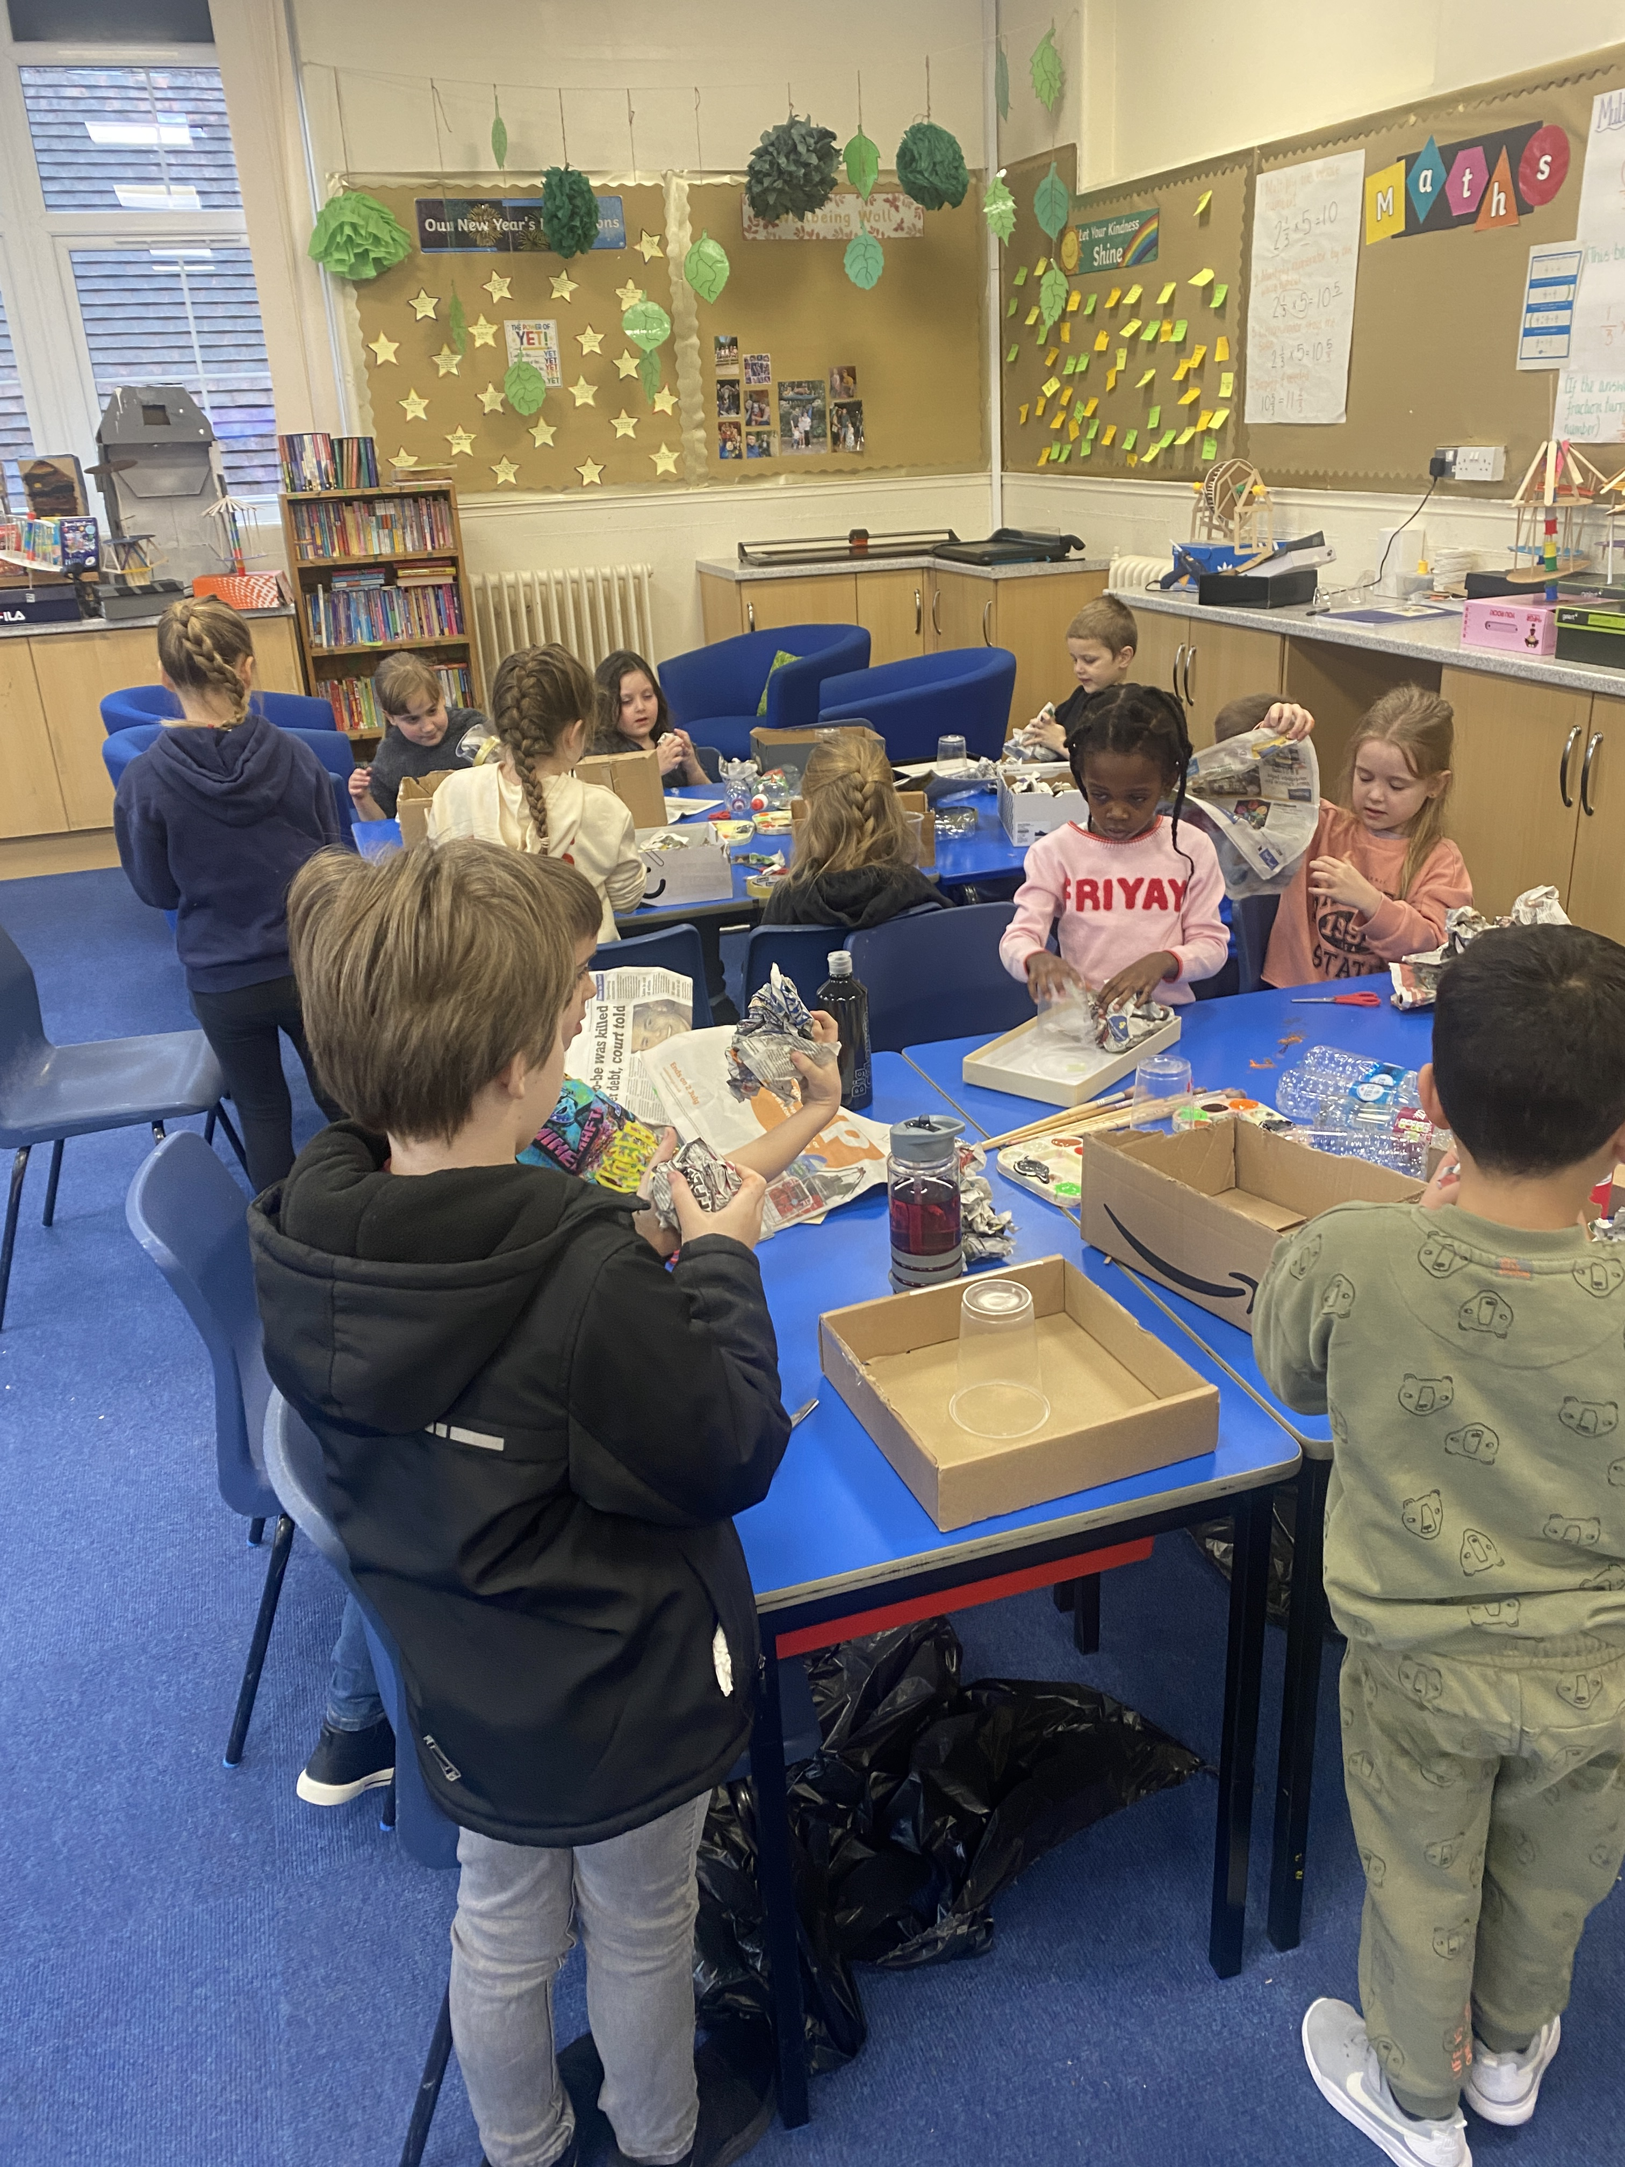
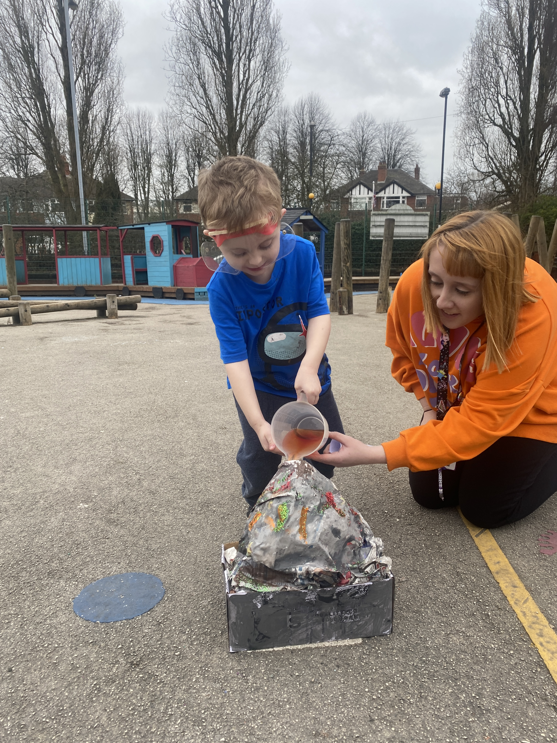

Slide 3
