Slide 1
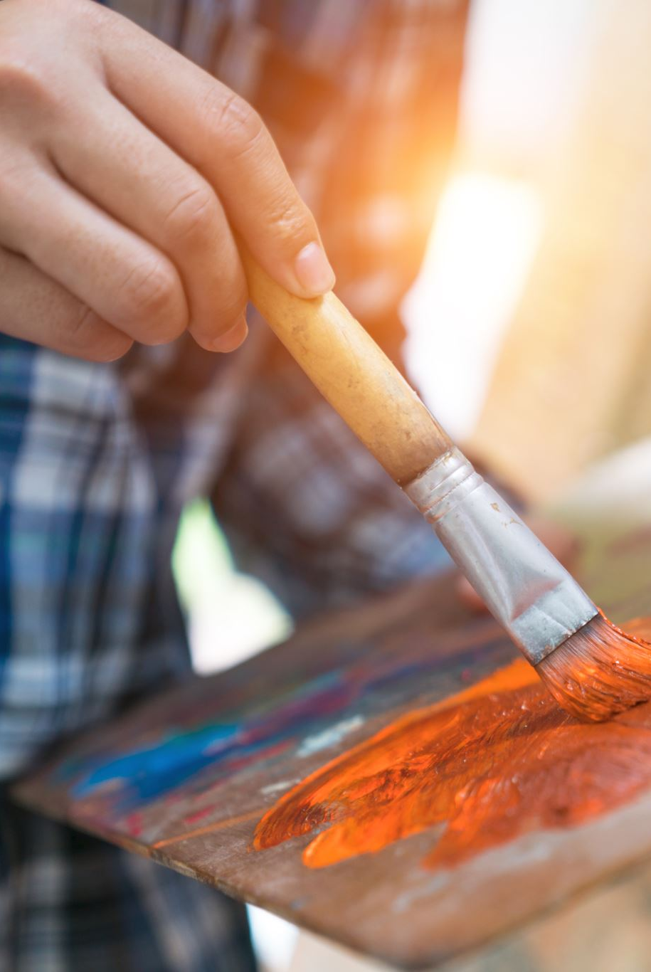
Art on saturday
In Saturday Art, we looked at the artist Jasper Johns (1930-present) and focused on his work called ‘Flag’. We created our own flag painting in a similar style and also a new flag for Churchfields Primary School. We also explored improving our painting techniques.

Slide 2
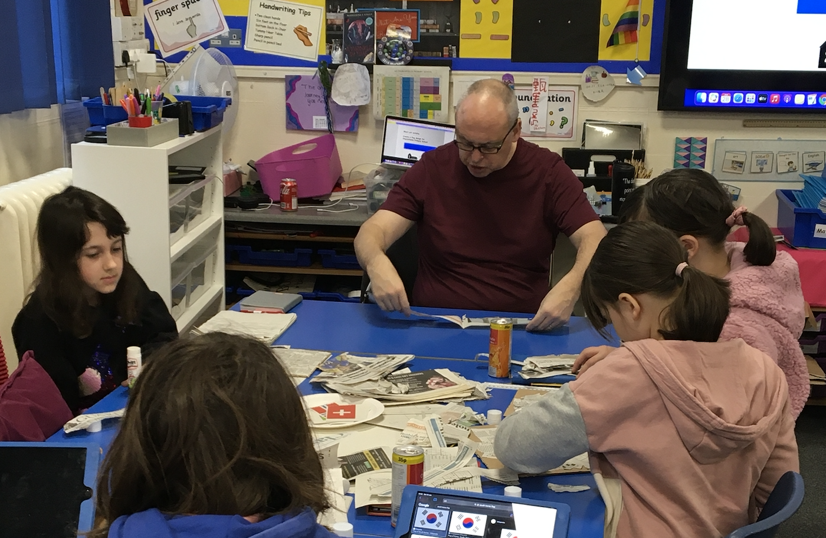
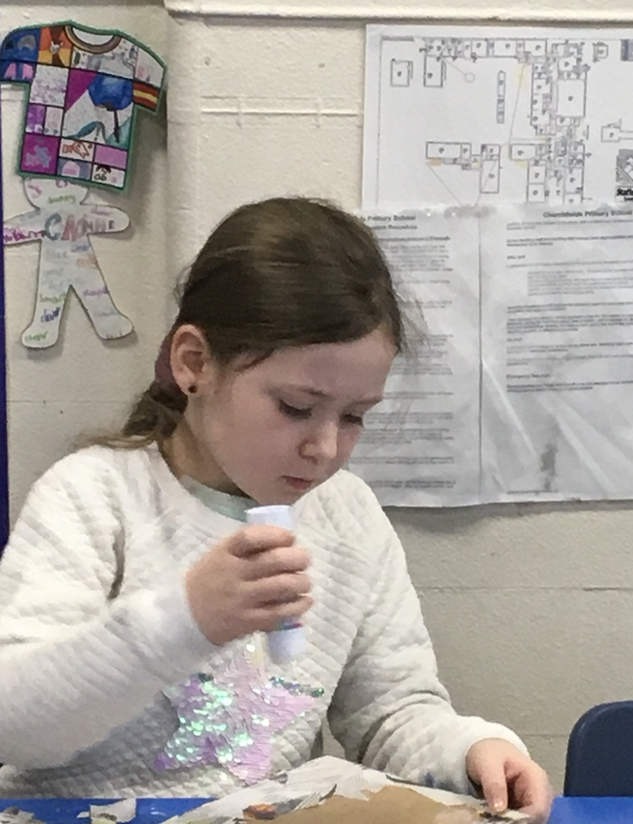

Slide 3
